Slide 1
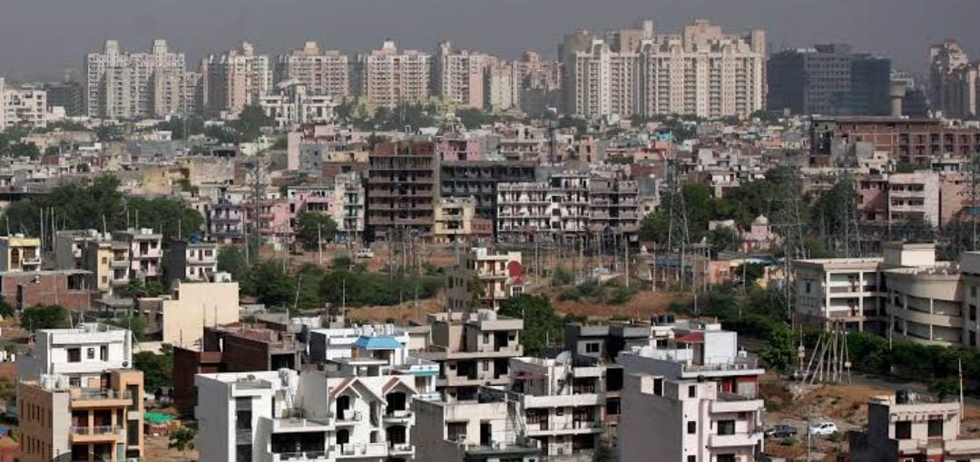
NAAN MULTHAVAN
ANALYSING HOUSING PRICES IN METROPOLITAN AREAS OF INDIA
TEAM: R.JAYA SAKTHI
B.KAVIYA
J.KAVIYA
S.KAVIYA
ANALYSING HOUSING PRICES IN METROPOLITAN AREAS OF INDIA
R.JAYA SAKTHI
B.KAVIYA
J.KAVIYA
S.KAVIYA

Slide 2
ANALYSING HOUSING PRICES IN METROPOLITAN AREAS OF INDIA
1.INTRODUTION
Analysing housing prices in metropolitan areas of India involves a comprehensive study of the real estate market in major cities like Mumbai, Delhi, Bangalore, and others. This analysis typically includes factors such as property values, demand and supply dynamics, economic indicators, government policies, and socio-cultural aspects impacting the housing market. It aims to provide insights into the trends, drivers, and challenges within the real estate sector, helping potential buyers, investors, and policymakers make informed decisions. Analysing housing prices in metropolitan areas of India involves a comprehensive study of the real estate market in major cities like Mumbai, Delhi, Bangalore, and others. This analysis typically includes factors such as property values, demand and supply dynamics, economic indicators, government policies, and socio-cultural aspects impacting the housing market. It aims to provide insights into the trends, drivers, and challenges within the real estate sector, helping potential buyers, investors, and policymakers make informed decisions.
PURPOSE :
Investment Decision-Making: Investors use housing price analysis to identify lucrative real estate opportunities. They can make informed decisions regarding buying, selling, or holding properties based on market trends.
Financial Planning: Homebuyers and property investors use this analysis to plan their budgets and understand the affordability of properties in different locations.
Policy Formulation: Governments and local authorities rely on housing price data to develop housing policies, address housing shortages, and regulate the real estate market effectively.
Economic Indicators: Housing prices can be indicative of the overall economic health of a metropolitan area. Rising prices may signify economic growth, while declining prices might signal economic challenges.
Social Impacts: Understanding housing prices helps policymakers address social issues such as affordable housing, gentrification, and urban development to ensure balanced and sustainable growth.

Slide 3
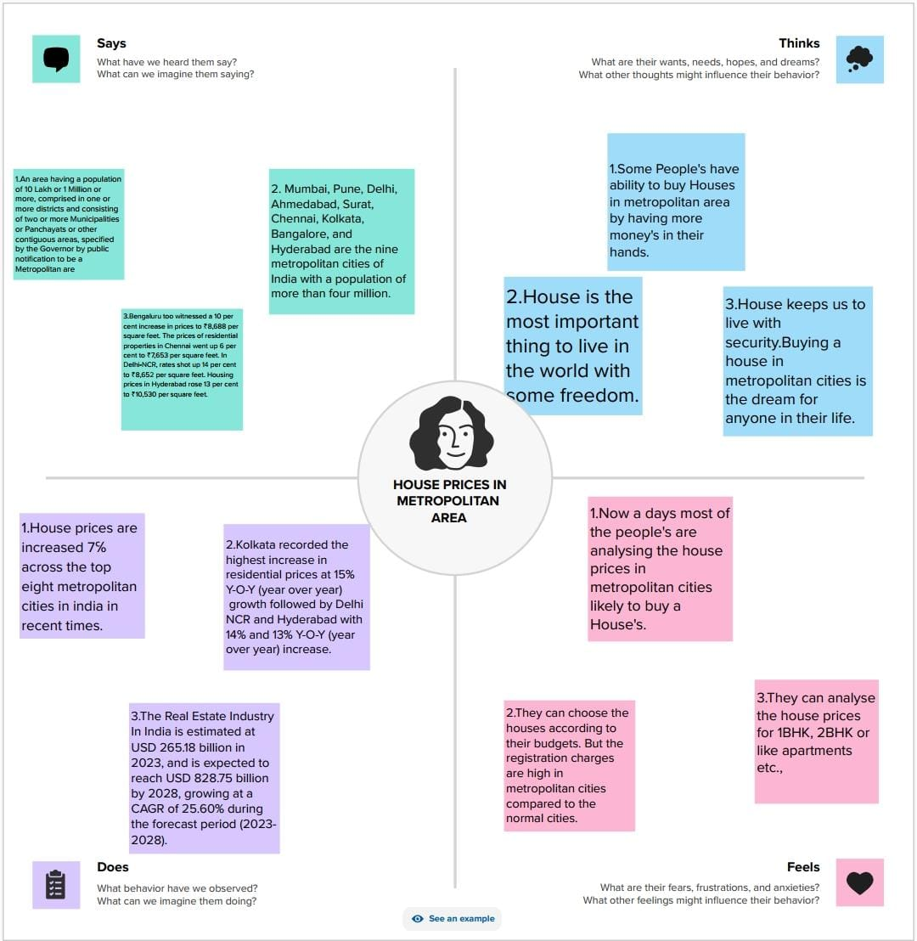
2.PROBLEM DEFINITION AND DESIGN THINKING:
EMPATHY MAP:

Slide 4
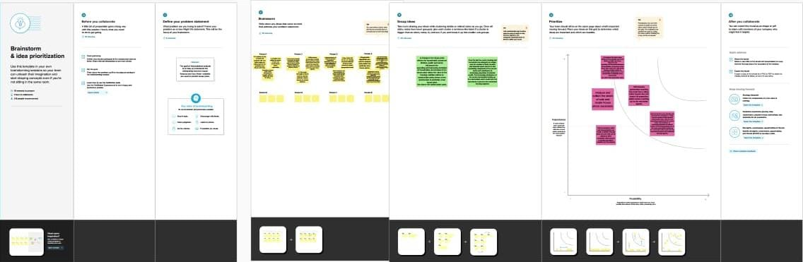
IDEATION AND BRAINSTORMING MAP:
BRAINSTORMING MAP:

Slide 5
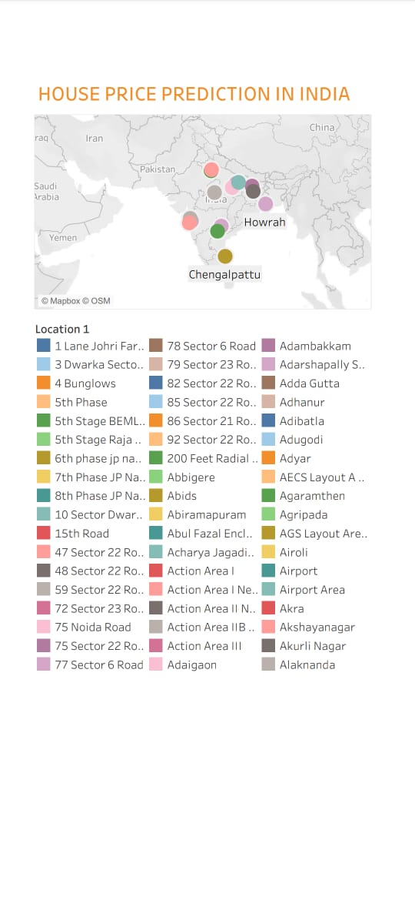
3.RESULTS

Slide 6
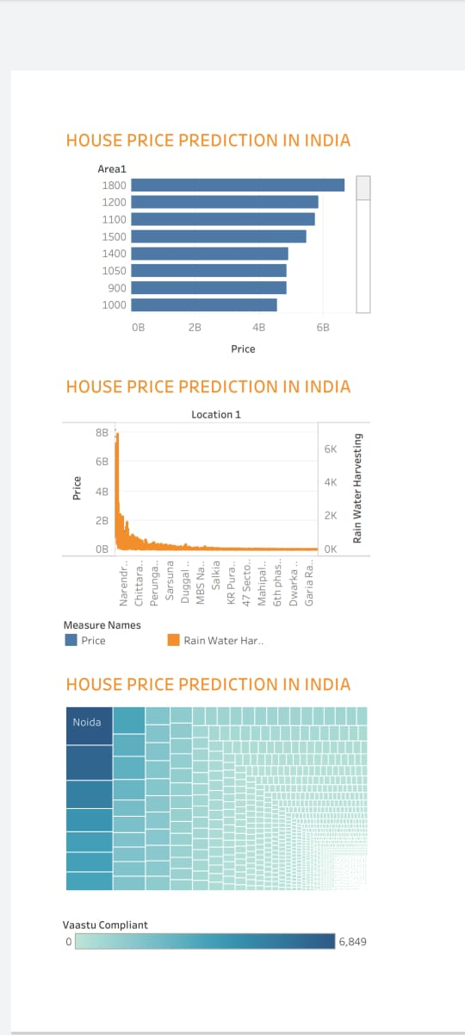

Slide 7
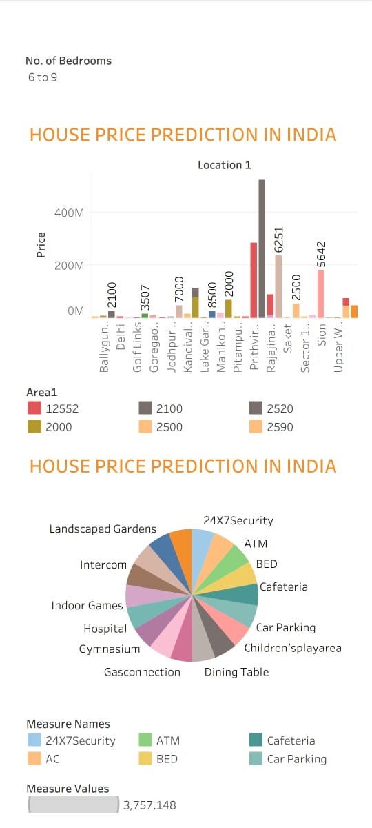

Slide 8
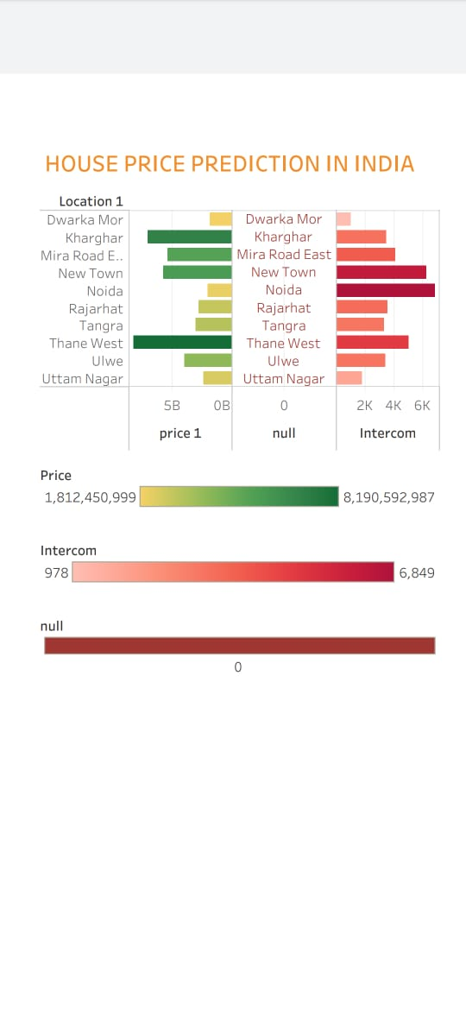
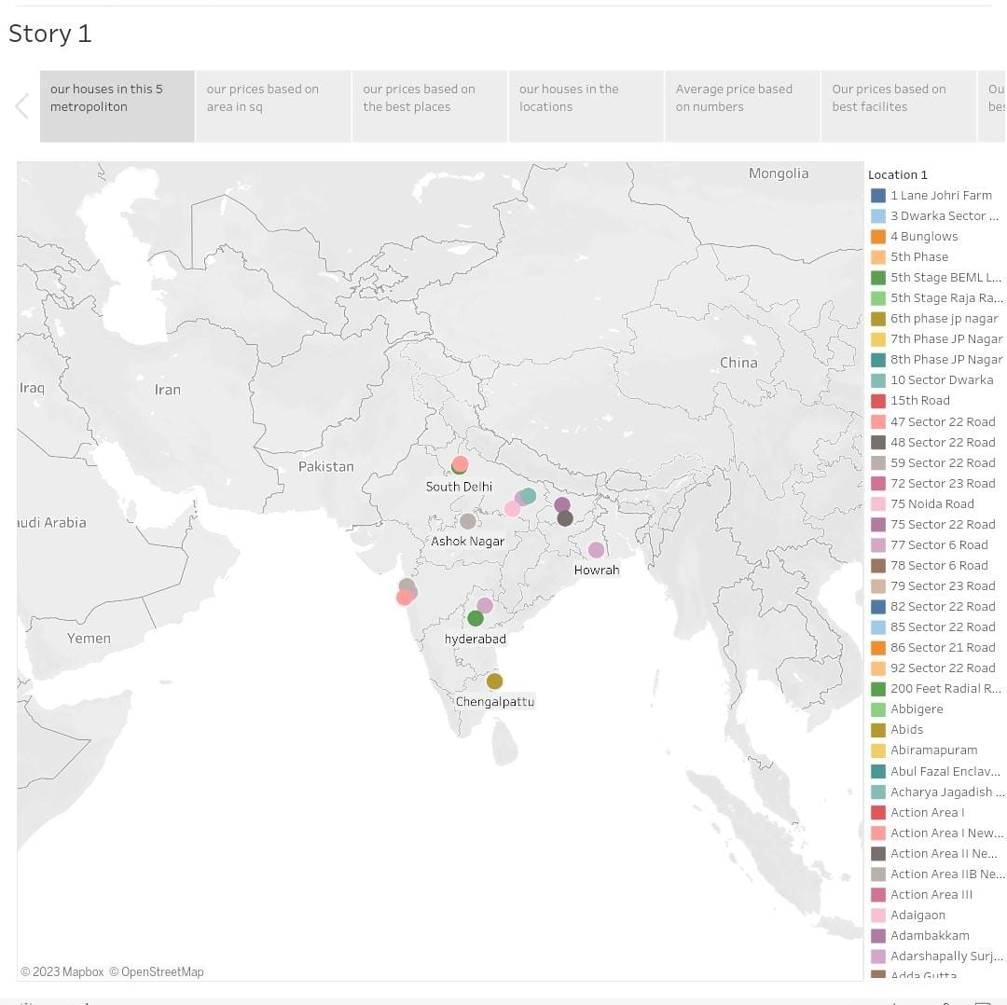

Slide 9
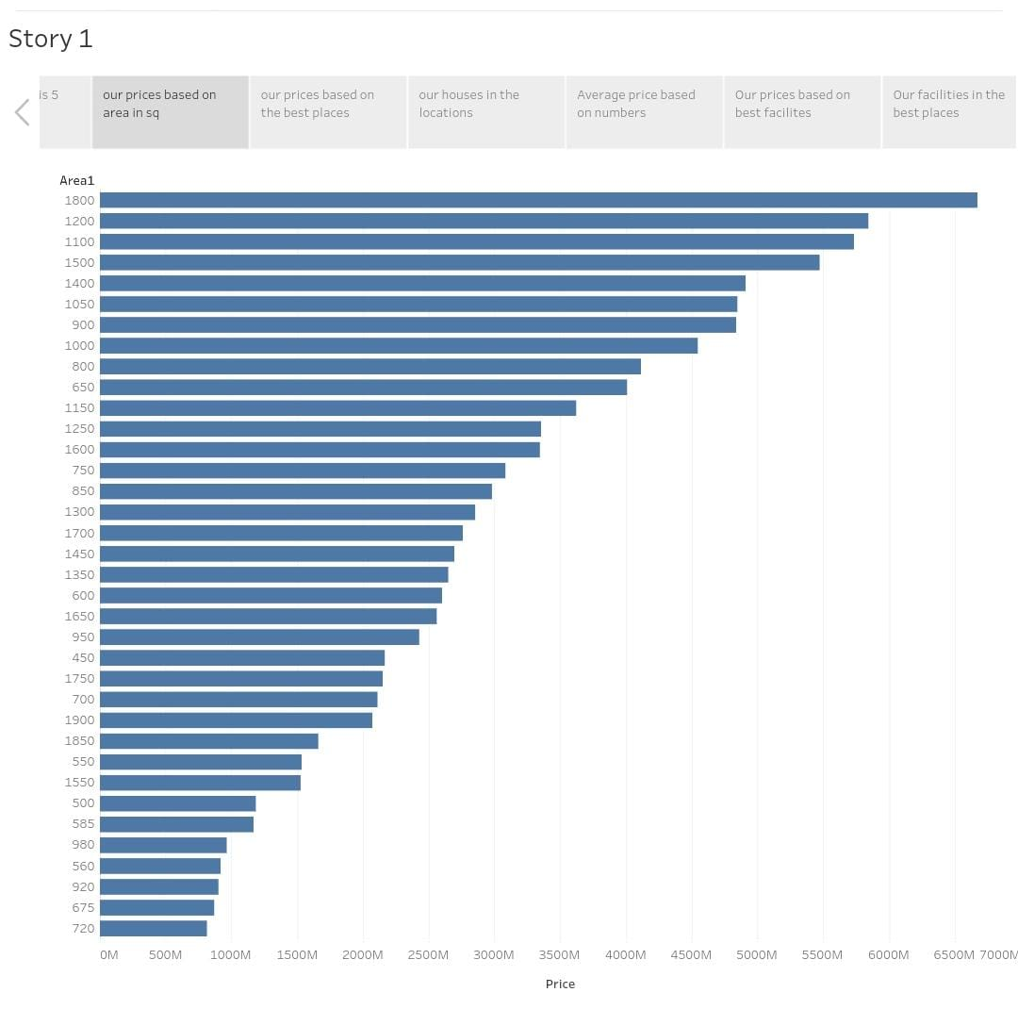
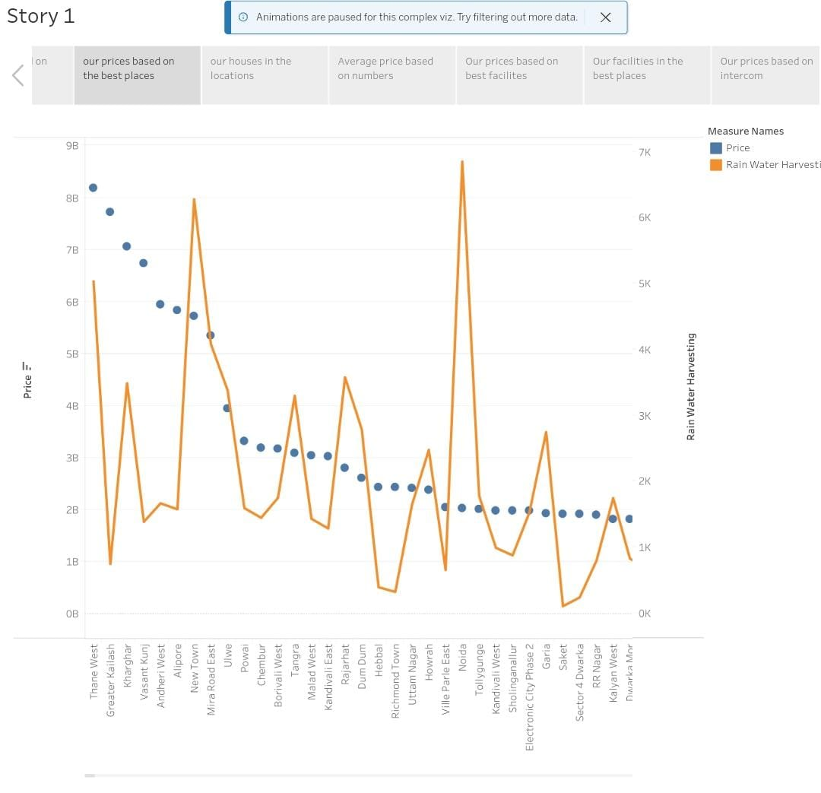

Slide 10
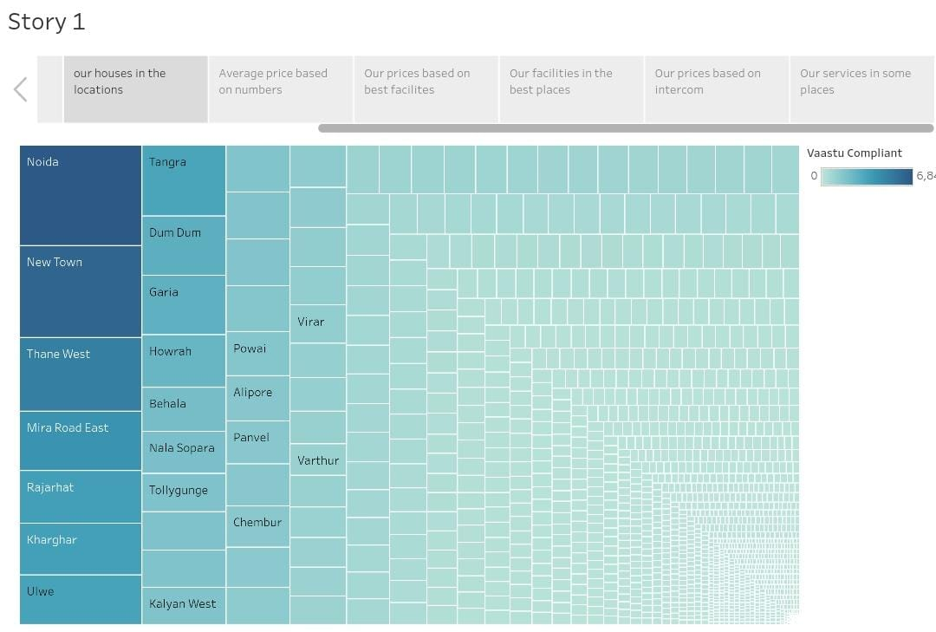
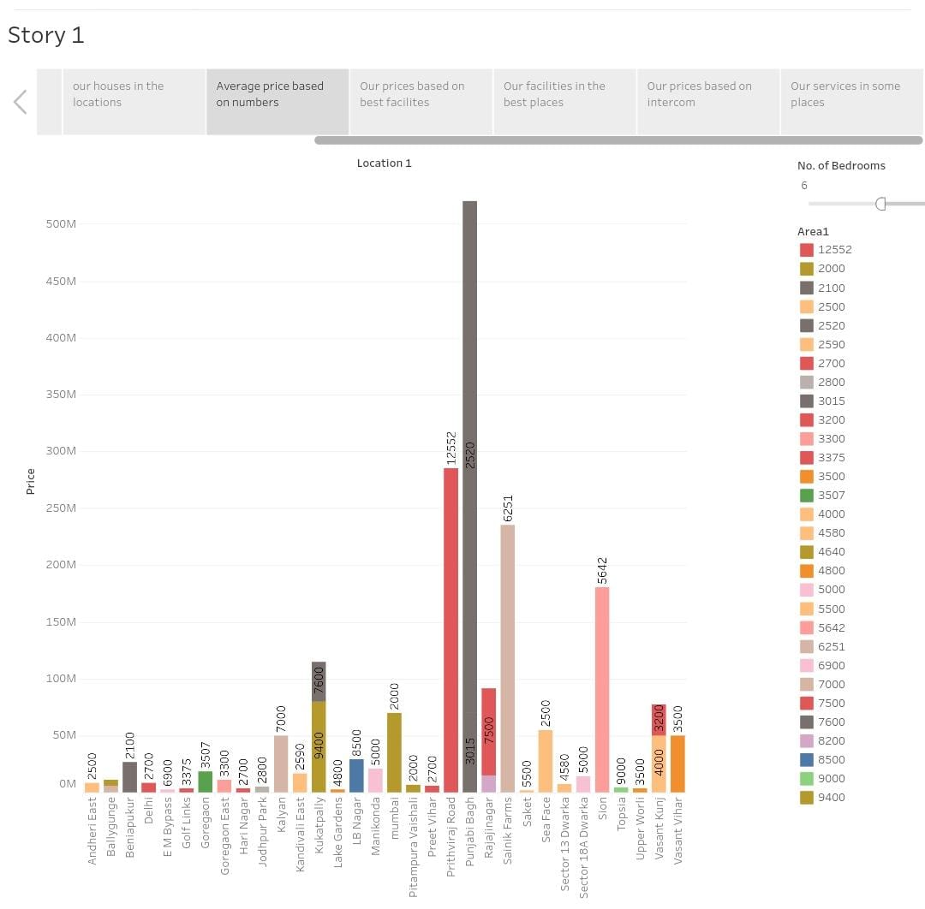

Slide 11
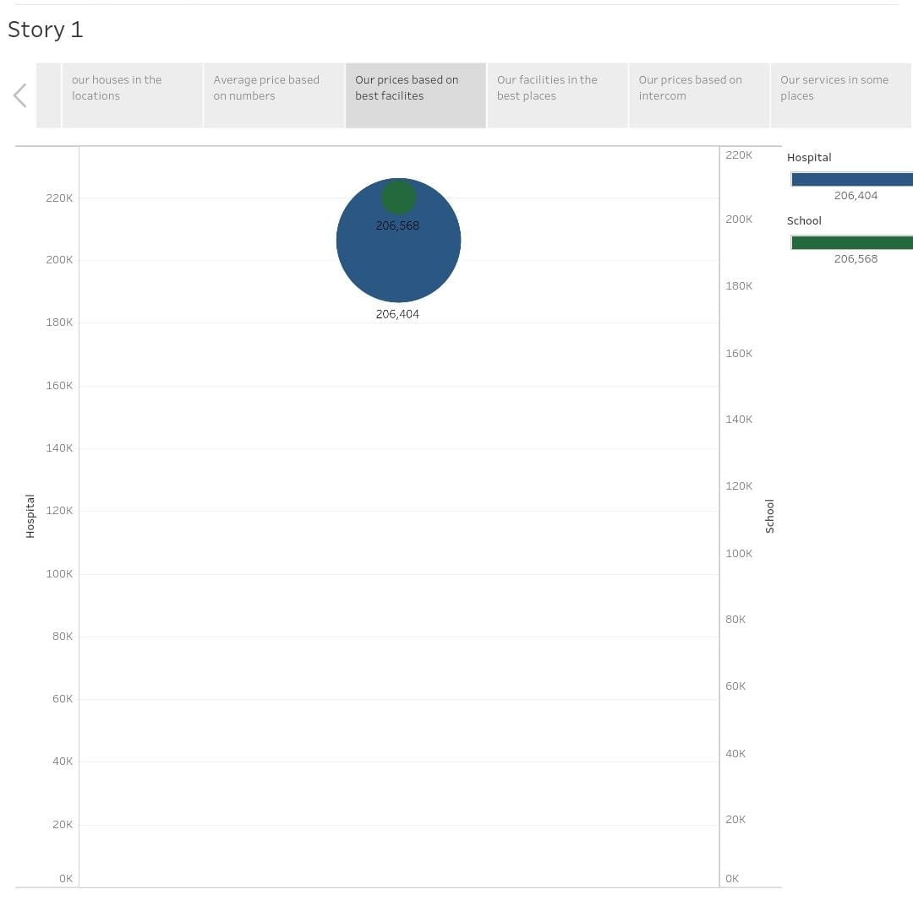
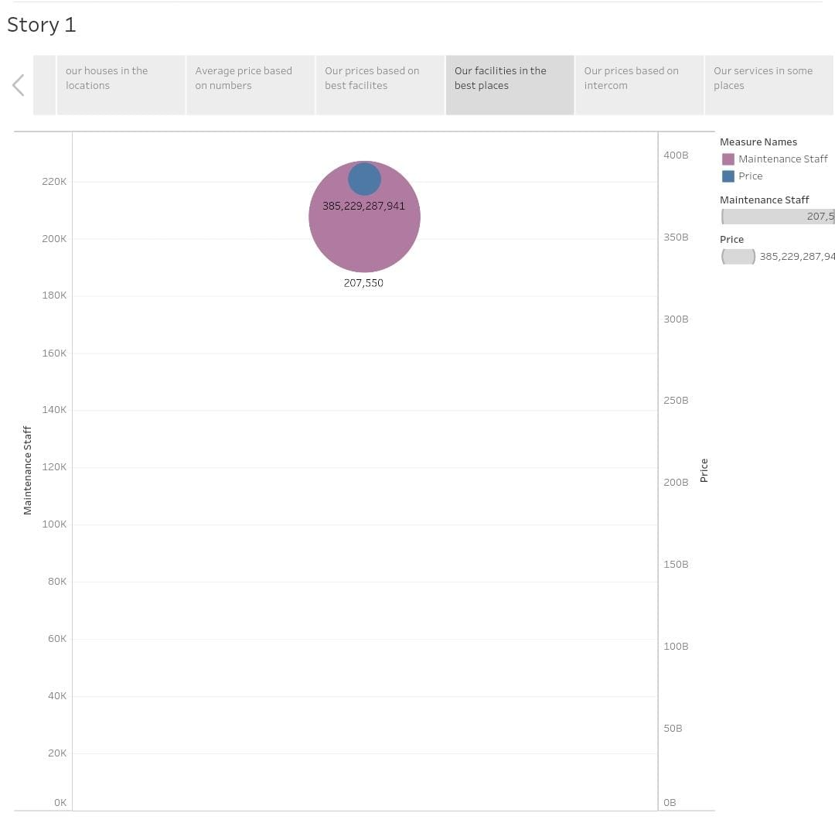

Slide 12
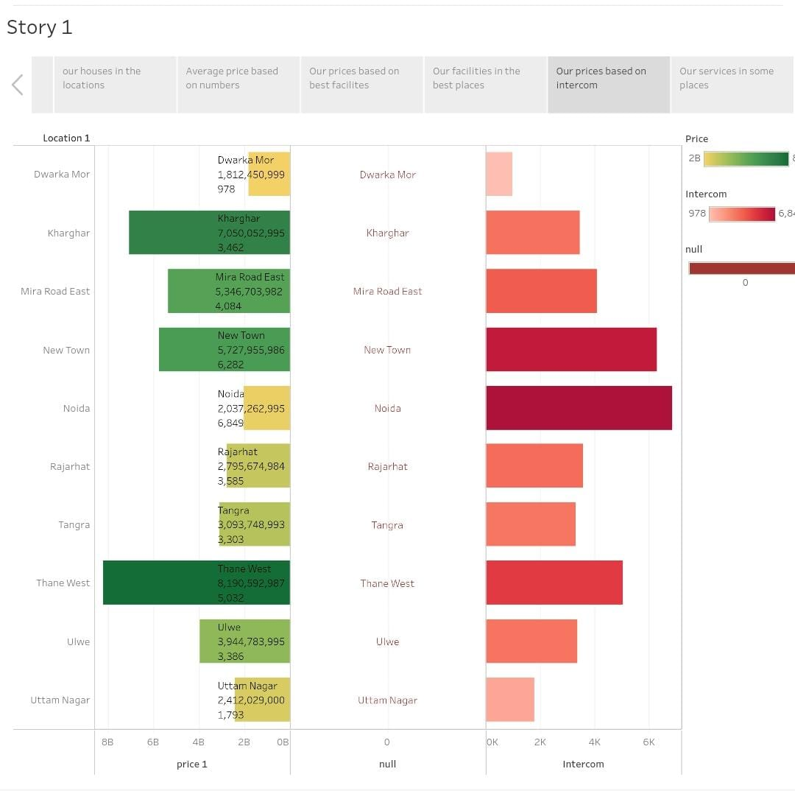
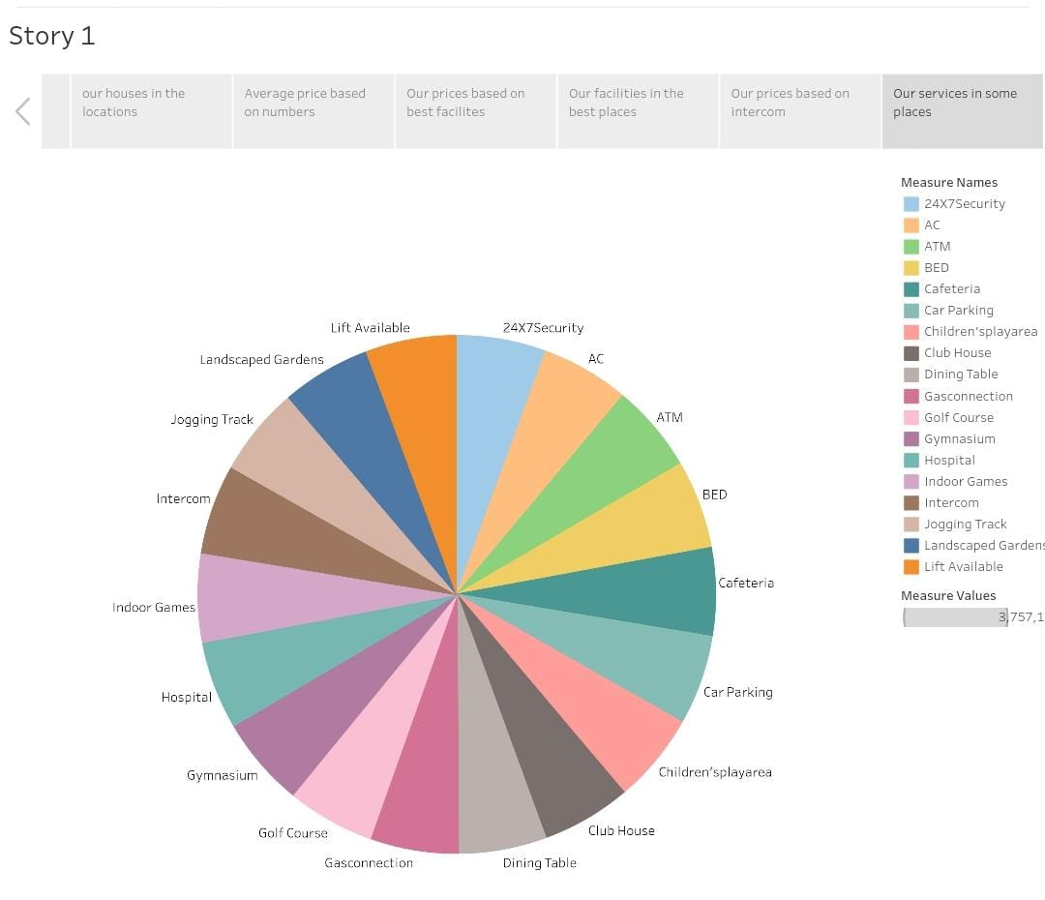

Slide 13
4 .ADVANTAGES & DISADVANTAGES
DISADVANTAGE :
Data Accuracy: Housing price data may not always be accurate or up to date, potentially leading to incorrect conclusions.
Market Volatility: Real estate markets can be volatile, making predictions based solely on past data challenging.
Regional Variability: India is a vast and diverse country, and housing markets can vary significantly between different metropolitan areas and regions.
Socioeconomic Factors: Housing prices are influenced by various socioeconomic factors, and ignoring these can lead to a limited perspective on the market.
ADVANTAGE :
Investment Insights: Analyzing housing prices can provide valuable insights for real estate investors, helping them make informed decisions on where to invest for potential returns.
Economic Indicator: Housing prices often serve as an economic indicator, reflecting the overall health and growth of the local economy.
Policy Planning: Governments and city planners can use this data to develop policies and urban planning strategies that address housing affordability and availability.
Market Trends: Understanding housing price trends can assist homebuyers in making sound financial choices and timing their purchases.

Slide 14
5.APPLICATIONS
Policy Making: Government policymakers can formulate housing and taxation policies based on the data to ensure affordability and sustainable urban development.
Real Estate Agents: Agents can use this data to advise clients on buying or selling properties and to understand market trends.
Research and Academia: Researchers can use the data to study the impact of housing prices on various social and economic factors.
Market Analysis: Businesses related to construction, home improvement, and real estate services can analyze the data to target their services effectively.
Real Estate Investment: Investors can use this data to identify areas with potential for high returns and make informed decisions about where to invest in property.
Homebuyers: Prospective homebuyers can assess whether they can afford properties in a specific metropolitan area, helping them make more informed choices.
Urban Planning: Municipal governments can use housing price data to plan infrastructure development and assess the need for affordable housing in rapidly growing cities.
Economic Analysis: It offers insights into the economic health of a region, as rising property prices may indicate economic growth.

Slide 15
6.CONCLUSION
The dynamic nature of these markets calls for continual analysis to address affordability challenges, foster sustainable development, and ensure equitable resource allocation.
Accurate housing price analysis serves not only as an economic barometer but also as a catalyst for shaping the quality of life and prosperity of India's urban population.
Analyzing housing prices in India's metropolitan areas is a pivotal endeavor with significant implications for various stakeholders.
It provides invaluable insights for investors, homebuyers, policymakers, and urban planners, enabling informed decision-making.

Slide 16
7.FUTURE SCOPE
Investment Opportunities: As metropolitan areas continue to attract investment, understanding housing prices is crucial for real estate investors.
Affordability Issues: Housing affordability is a major concern in Indian metropolitan areas. Analyzing price data can shed light on affordability challenges and potential solutions.
Real Estate Technology: Proptech (real estate technology) is evolving, making it easier to access and analyze housing data. This enhances the scope for innovation in this field.
Market Volatility: Housing markets can be volatile. Analyzing data can help predict and mitigate risks associated with market fluctuations.
Sustainability and Smart Cities: The concept of smart cities and sustainable housing is gaining momentum. Analyzing housing data can contribute to the development of such initiatives.
Urbanization: India is witnessing rapid urbanization, leading to increased demand for housing in metropolitan areas. Analyzing this data can provide valuable insights into housing trends and market dynamics.
Data Availability: With the advent of technology, there is a wealth of data available for analysis. This includes historical pricing data, property features, location data, and economic indicators.
Machine Learning: Advanced machine learning models can be applied to predict housing price trends, helping buyers, sellers, and investors make informed decisions.
Policy Changes: Housing policies and regulations often change, affecting prices. Analyzing how these policies impact the market can be critical for stakeholders.

Slide 17


